Slide 1

PROJECT REVIEW
Nimisha mm r.no:24 S3 MCA

Slide 2
BLOCKCHAIN BASED AIRLINE RESERVATION SYSTEM

Slide 3
RELEVANCE OF THE TOPIC
The air transport industry has been predominantly traditional, based on long-established business models and archaic IT systems
Distribution has changed over the years, from an independent department to a collaboration with pricing, marketing, revenue management, sales, etc. therefore need a collaborative technology.
There is rising need for Airlines to be able to quickly and effectively change prices or add ancillaries without any intermediaries or delays. This would also allow travellers flexibility and lower costs for all.

Slide 4
DESCRIPTION OF TOPIC
In this paper, the main objective of the Airlines reservation system is to implement software that accompanies blockchain technology considering the airline sector challenges.
It helps users to reserve tickets for air service and track the updated status periodically. Blockchain technology keeps the data secured and centralized providing efficient usage via mobile apps or online.
The system provides an efficient user interface for both customers and stakeholders and analyzes the behavior of the customer and provides efficient results.

Slide 5
OBJECTIVE
In this project, our objective is to build the Airline Reservation System like the Winding Tree Platform system.
Ultimately, there is no difference in the ticket itself. The difference lies in the back end and the way the ticket is distributed and purchased .
What blockchain does is essentially serve as a neutral computing system. This system acts as a transparently level playing field and a way for different companies to directly share data more efficiently and effectively in real time.

Slide 6
airlines need systems that speak to each other. Distribution has changed over the years, from an independent department to a collaboration with pricing, marketing, revenue management, sales, etc. Therefore need a collaborative technology.
There is rising need for Airlines to be able to quickly and effectively change prices or add ancillaries without any intermediaries or delays. This would also allow travellers flexibility and lower costs for all.

Slide 7
WINDING TREE:
A decentralized open source B2B travel marketplace,a platform where buyers and sellers of travel inventory may find trusted partners they could not find before,connected imme.
Winding Tree has built a decentralised travel marketplace using a robust Ethereum blockchain that directly connects buyers and suppliers in a peer-to-peer environment.
As the industry embraces direct distribution through decentralized marketplaces Winding Tree lowers distribution costs while enabling greater customer knowledge and intimacy

Slide 8
some advantages are:
With blockchain, one airline might directly purchase a seat on another airline for a customer who's booked a connecting flight rather than depending on the local site again.
In the event of a delay, an airline can more easily find vacancies in local hotels for its passengers, and organise a bus service for them to get there and back, rather than frantically phone around for available services.
Can exclude the presence of third parties.

Slide 9
MODULES
Cost Prediction
Enabling wallet
Generating Ether value
Ticket booking
Staus Checking
Cancellation of ticket

Slide 10
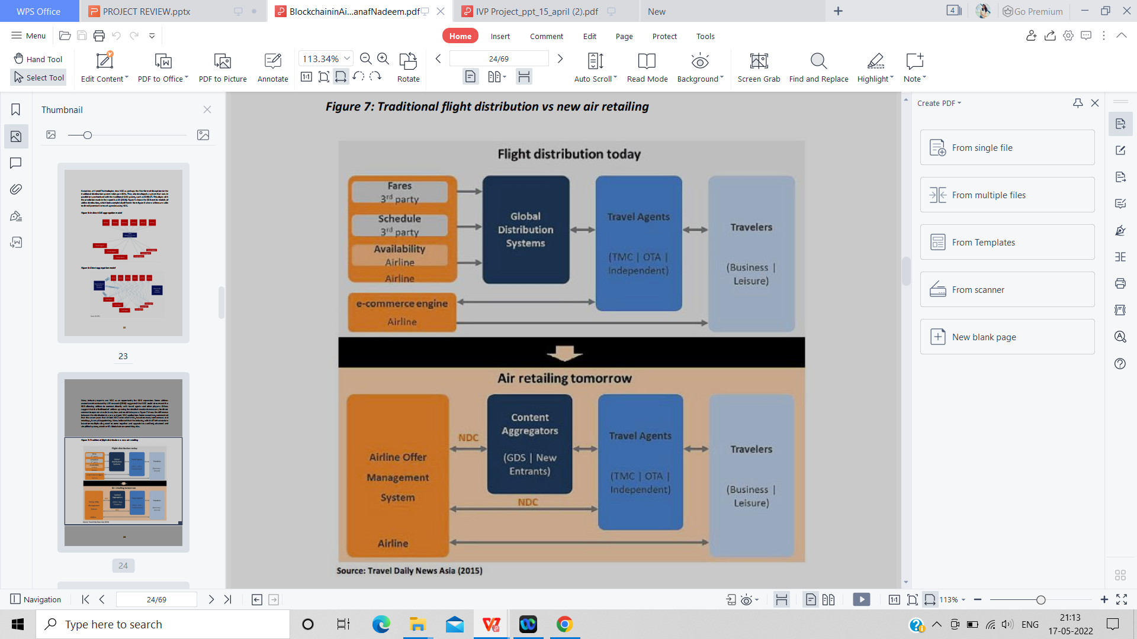

Slide 11
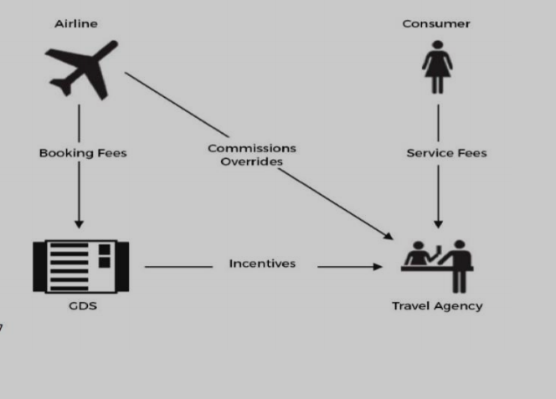
COST FLOW

Slide 12
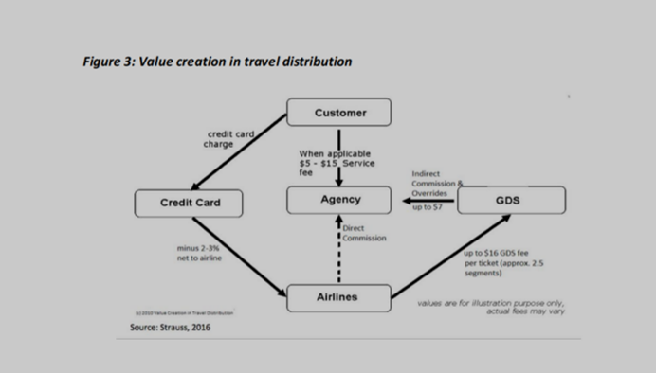

Slide 13
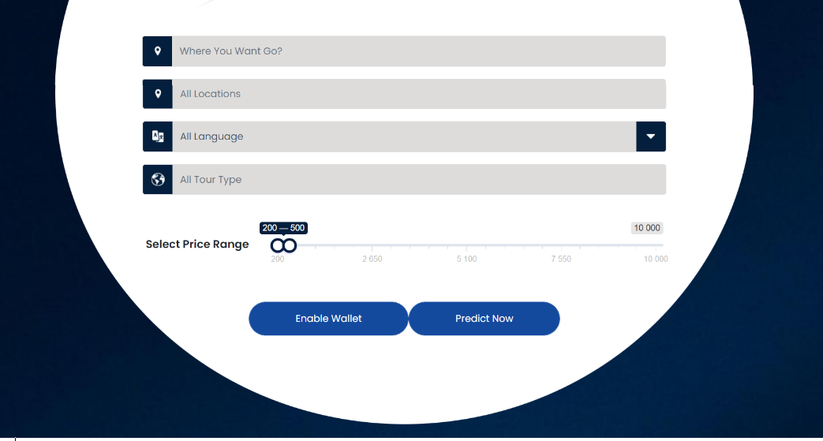
USER INTERFACE

Slide 14
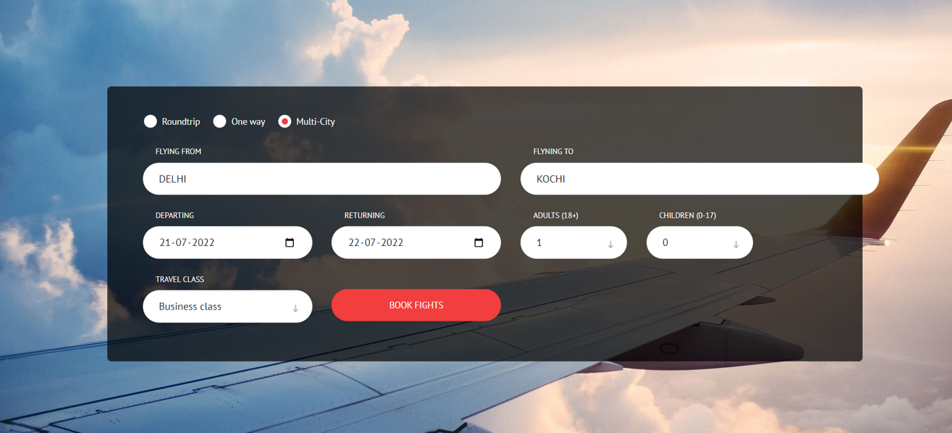

Slide 15
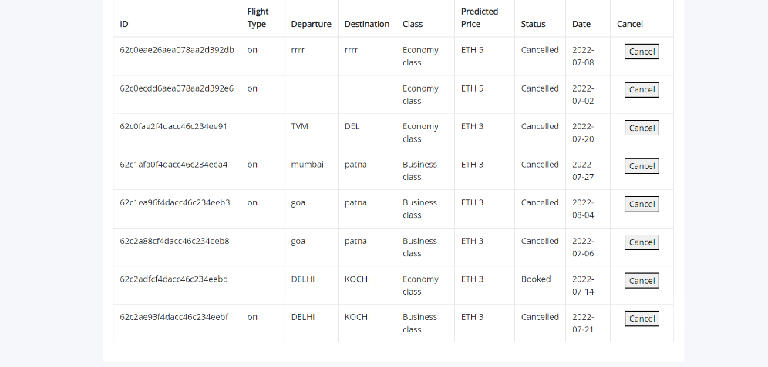

Slide 16
FUTURE SCOPE OF THE PROJECT
Makes the whole airline system more flexible and easy to use
More secure.

Slide 17


